Slide 1
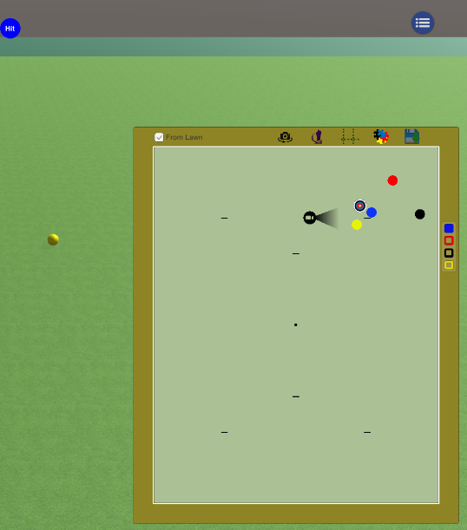
Croquet and Gateball Simulators
Gareth Denyer
gareth.denyer@sydney.edu.au or gareth.denyer@me.com

Slide 2
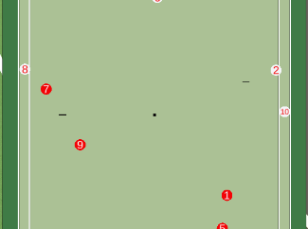
Purpose
Set up and save scenarios
Experiment with lines of play
Using the Physics Engine of Unity
Replay – Productive Failure
Adjust player attributes
Accuracy aim/length, other skills
Record Games
Play against others

Slide 3
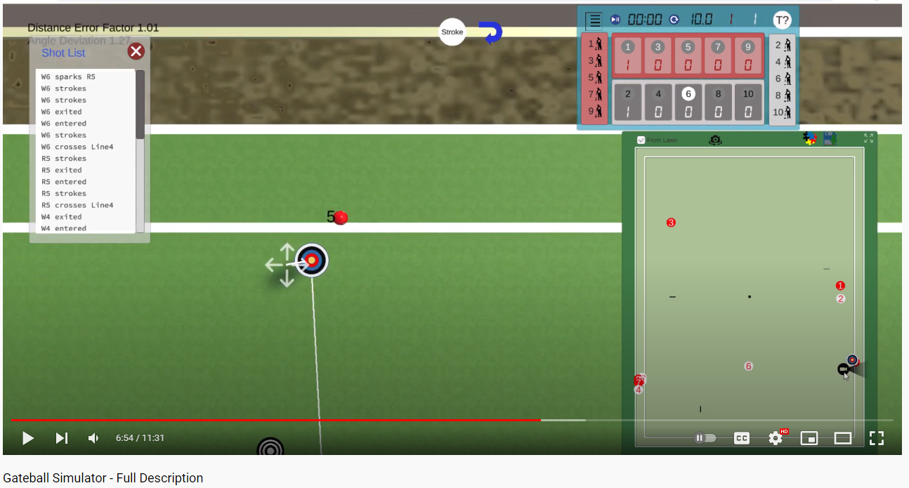
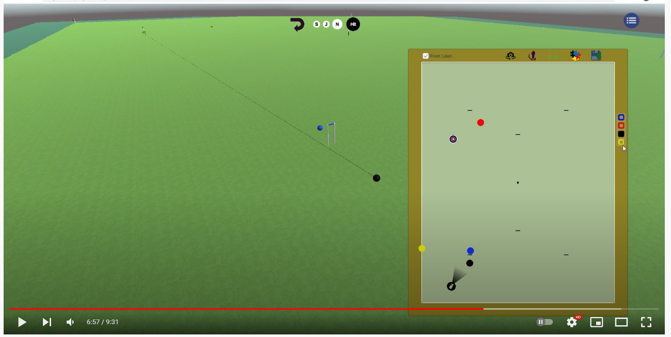
Current Versions
https://garethdenyer.github.io/gc/
https://garethdenyer.github.io/gc2/
BOTH addresses work for now – updates alternate between each
Will have a proper system for this soon ☺
Gateball Intro Video https://www.youtube.com/watch?v=zO3czCRvp2E
GC Intro Video https://www.youtube.com/watch?v=smHI7pY_HUw

Slide 4
Please Have a Go….
Give feedback and suggestion to
gareth.denyer@sydney.edu.au or gareth.denyer@me.com
So far great input from several folk, especially:
Greg Bury, Peter Landrebe, Peter Freer,
John Park, Kevin Beard,
Alison Sharpe, Alix Verge, Kate Patrick, Chris Lavina
Special thanks to my Unity Tutor, Rohann Dorabjee

